Slide 1

Open cart ​

Slide 2
Agenda
Project Planning & Management
API Testing
01
04
Create Test Cases & Test Scenarios
Automation Testing
02
05
Bug Report.
03

Slide 3
Open cart
Website Testing

Slide 4

Open cart
OpenCart is an online platform designed for creating eCommerce stores to sell products and services.It’s perfect for selling things like clothes, electronics, beauty products, books, and more – all online.

Slide 5

Project Planning & Management
01

Slide 6


OpenCart is a PHP-based e-commerce platform using MySQL and HTML. This test plan focuses on validating core features from both the Frontend (User Interface) and Admin Panel to ensure functionality, performance, and quality.
Scope:Frontend: Registration, Search, Cart, Checkout, Orders, Filters, Account.Admin Panel: Customers, Sales, Orders, Reviews, Content Management.
Quality Objectives:Ensure system stability, usability, and bug-free experience before release.
Testing Types:Agile-based manual testing: Functional, Integration, Performance, Regression, UAT.
Test Strategy:Excel for test cases, Jira for bug tracking, peer reviews, and regular regression runs.
Entry & Exit Criteria:Start: Test cases approved, Smoke test passed.End: All tests executed, major bugs fixed, UAT signed off.
Team & Tools:QA Lead & 3 Engineers using Excel, Jira, GitHub across modern browsers.
Risks:Browser compatibility, internet issues, resource availability. KPIs:80% test coverage, 15–30% bug detection rate, API response time < 1s.

Slide 7

Create Test Cases & Test Scenarios
02
https://docs.google.com/spreadsheets/d/17sSzxwTezDxloxWqP1RF0QhBopHwb4w6/edit?usp=drive_link&ouid=116674362915297218066&rtpof=true&sd=true

Slide 8
Sara abdullwhab
Khaled Wael
(QA Lead) Designed and reviewed test cases for core business flows (e.g., registration, checkout, and order management)
Supervised overall test case execution and defect tracking
Handled test planning, traceability, and QA reporting
Focused on UI/UX consistency and cross-browCreated test cases for product-related features (search, compare, wishlist, product details)
Marwa
Maria
Covered Admin Panel modules: customer management, reviews, filters, and information pages
Designed test cases for CRUD operations
Conducted regression testing and peer reviews
Worked on account settings, order history, and checkout flows
Wrote test cases for negative scenarios and edge cases
Focused on payment gateway flows and currency selections

Slide 9
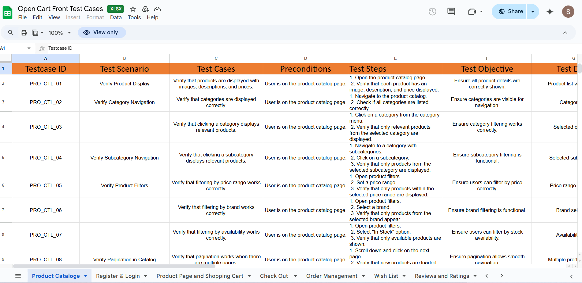
Manual Testing Platform: https://www.opencart.com Over 900+ manual test cases were designed and executed on the actual OpenCart environment to ensure proper functionality across both the frontend and admin panel. Test Coverage: Add, Edit, and Delete operations User registration, login/logout, and account management Product search, add to cart, wishlist, and full checkout Order tracking, returns, and contact forms Admin panel: manage orders, users, reviews, pages Documentation: Test cases recorded in Excel with detailed steps & expected results All mapped to functional requirements for traceability Peer-reviewed and validated by the QA team

Slide 10
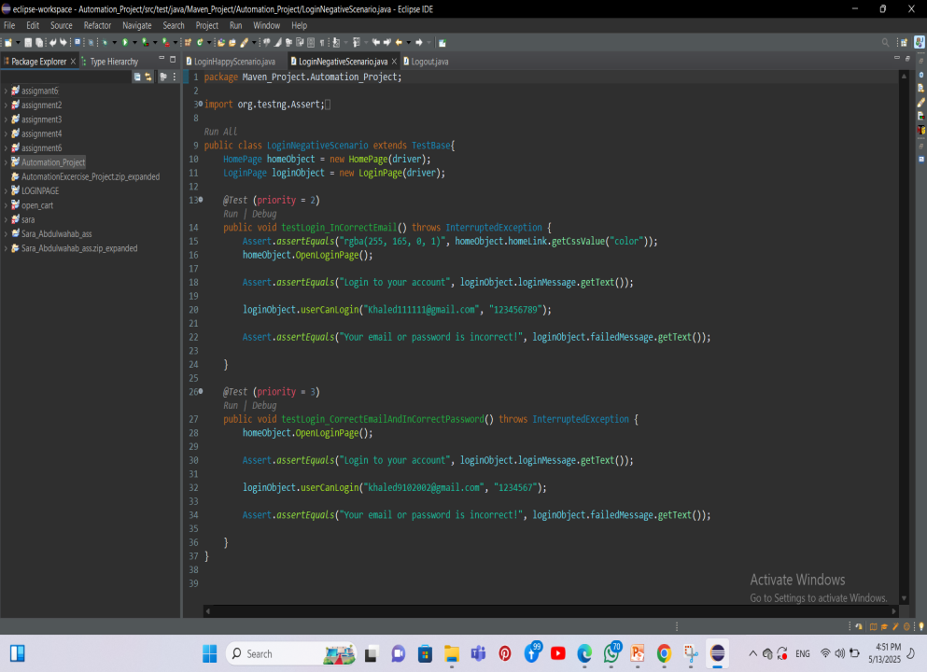
Automation Testing
Platform: Automation Exercise Site
Automation scripts were previously developed on a demo exercise site, which did not match the structure or behavior of OpenCart. As a result, the automation:
Missed key real-world flows
Did not reflect actual functional requirements
Produced unreliable results
Limitations:
No admin panel testing
Generic test data
Unrelated page structures
Superficial validations

Slide 11
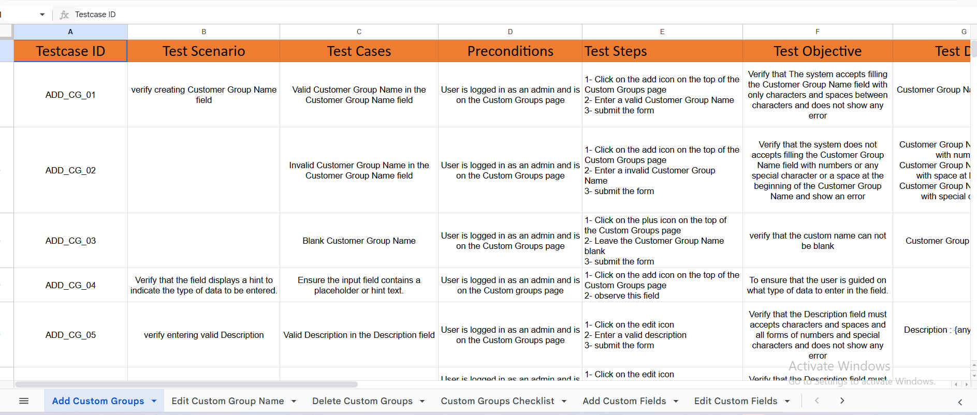
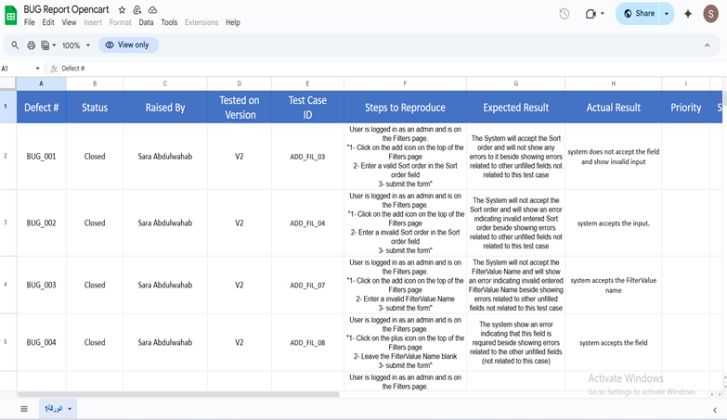
Maria Bug Report Preparation Maria collaborated with Marwa in preparing the Bug Report. Together, they identified and documented the bugs accurately, which contributed to resolving issues and improving the website’s overall functionality. Test Cases - Add Custom Groups Task: Maria worked on writing the Test Case for adding custom groups. She ensured that the feature functioned correctly by testing different scenarios and verifying that users could successfully create and manage custom groups.

Slide 12
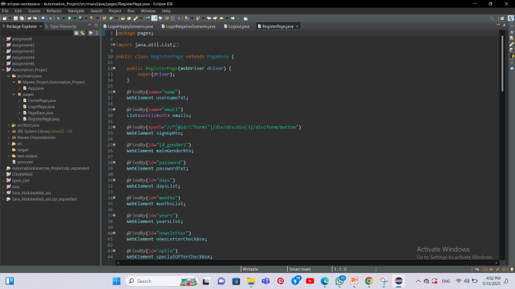
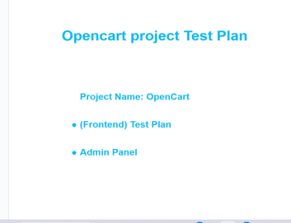
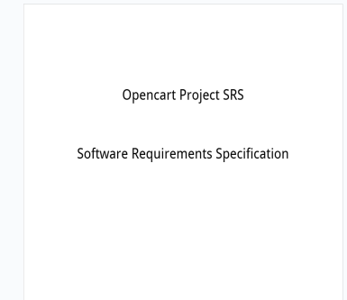
Khaled wael SRS Development Task: Khaled developed the Software Requirement Specification (SRS) for the website, outlining all the core features and functional requirements, ensuring a clear understanding of the project's goals and user needs. Test Plan Creation Task: Khaled created the Test Plan, detailing the testing strategy, scope, objectives, and the methods to be used to verify and validate the website's functionality. Automation Register Task: Khaled implemented the Automation Register, automating the registration process to ensure users can sign up seamlessly without any manual intervention, improving both speed and accuracy. Test Cases Task: Khaled wrote and executed several Test Cases, including: Test Case for Password Reset: Testing the process of resetting a user’s password to ensure the procedure works correctly and users can easily recover their accounts. Test Case for Product Search: Verifying that the search functionality returns accurate and relevant results based on user queries. Test Case for Order Confirmation: Ensuring that after a successful order, users receive an order confirmation email with the correct details. Test Case for User Profile Update: Testing whether users can update their personal information (such as email, address, and phone number) in their profiles correctly.

Slide 13

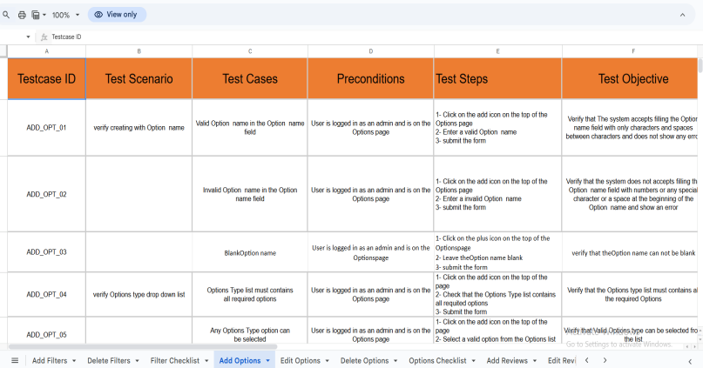
Sara abdullwhab Manual Test Cases Task: Sarah worked on Manual Test Cases to ensure the quality of the website. The tasks she worked on included: Add Customer: Testing the successful addition of new customers and verifying that all required fields are validated properly. Edit Customer: Testing the ability to update customer details and ensuring that changes are saved and reflected accurately. Delete Customer: Testing the deletion of customer records and confirming that the process removes the correct entry without affecting others. Automation Testing Task: Sarah also worked on Automation Tests to ensure that key operations are performed automatically and correctly. The tasks she worked on included: Login Test: Testing the login process to ensure users can log in successfully. Logout Test: Testing the logout process to ensure users can log out correctly.

Slide 14
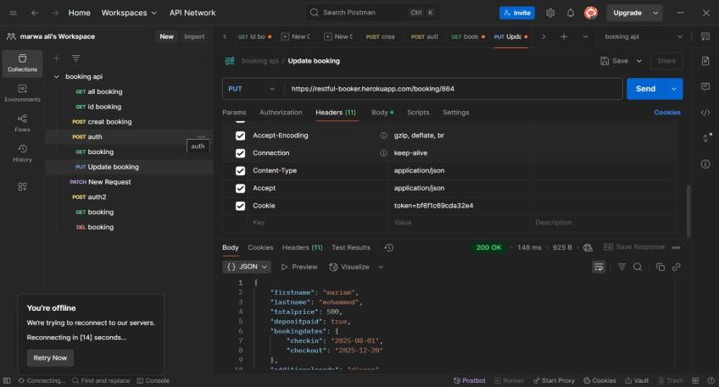

Marwa API Development Task: Marwa worked on developing the API for the website, focusing on improving the communication between the system and the database to ensure fast and efficient performance. Bug Report Preparation Task: Marwa collaborated with Maria in preparing the Bug Report. Together, they identified and documented the bugs accurately, which helped resolve issues quickly and improve the website’s overall performance.

Slide 15
Thank You

